Slide 1

Exam AZ-301: Microsoft Azure Architect Design Crash Course
Tim Warner

Slide 2


Tim Warner
Based in Nashville, TN, US
MCT, MVP
Twitter: @TechTrainerTim
Badge: timw.info/azarchcert

Slide 3

Tim Warner
timw.info/ms300
O’Reilly Online Learning

Slide 4
Course Materials
timw.info/az301

Slide 5
Session 1 of 2 Learning Goals
Introduction
Identity Design
Authentication
Authorization
Accounting (monitoring)
Data Platform Solution Design
Relational vs non-relational databases + optimization
Data protection of all stripes

Slide 6
Session 2 of 2 Learning Goals
Business Continuity / High Availability Design
Deployment, Migration, Integration Design
Exam AZ-301 certification strategy

Slide 7
Setting Expectations
Azure Architect is an expert-level certification
You should already know how to deploy and configure Azure resources
This is a "crash course"
Please plan to review these materials more than once
Five-minute break at midpoint
Please ask/answer questions and provide feedback in the Q/A panel, not the group chat

Slide 8
2020 Exam Update Information
Microsoft WorldWide Learning (WWL) revisits the Azure role-based certs yearly
Relevant blog post: timw.info/az2020
Changes:
AZ-300 replaced with AZ-303
AZ-301 replaced with AZ-304
AZ-304 beta will be available ~ April 28, 2020
AZ-301 will remain in market until or around July 28, 2020

Slide 9
2020 Exam Update Strategy
You can earn your badge by combining the old and new exam versions:
AZ-300 and AZ-304
AZ-301 and AZ-301
The certification is the same, and has a 2-year expiry
If you’re already prepping for AZ-300, stay the course!
Beta sometimes takes a long time
Cert prep vendors need time to develop new materials

Slide 10
Tim's Certification Study Pyramid
Interdependence
Content knowledge
Practical application
Test-taking skills

Slide 11
Consumption, Auditing, Monitoring Design

Slide 12
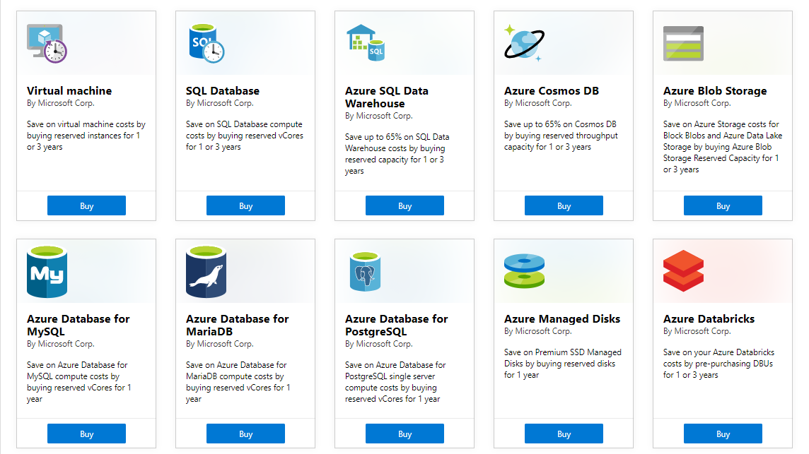
Azure Reservations

Slide 13
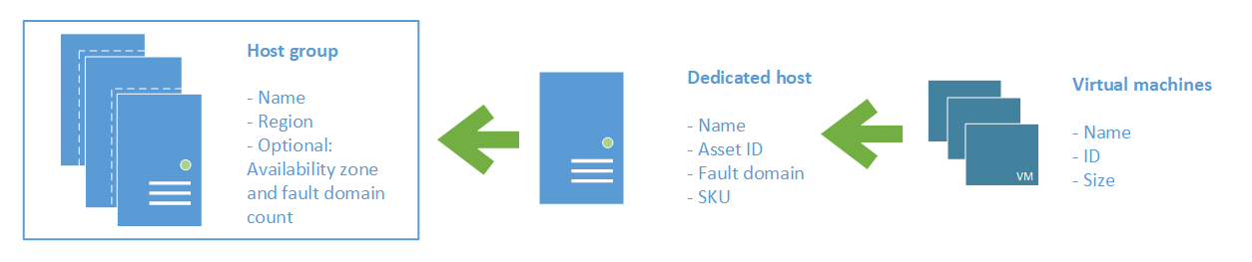
Azure Dedicated Host

Slide 14
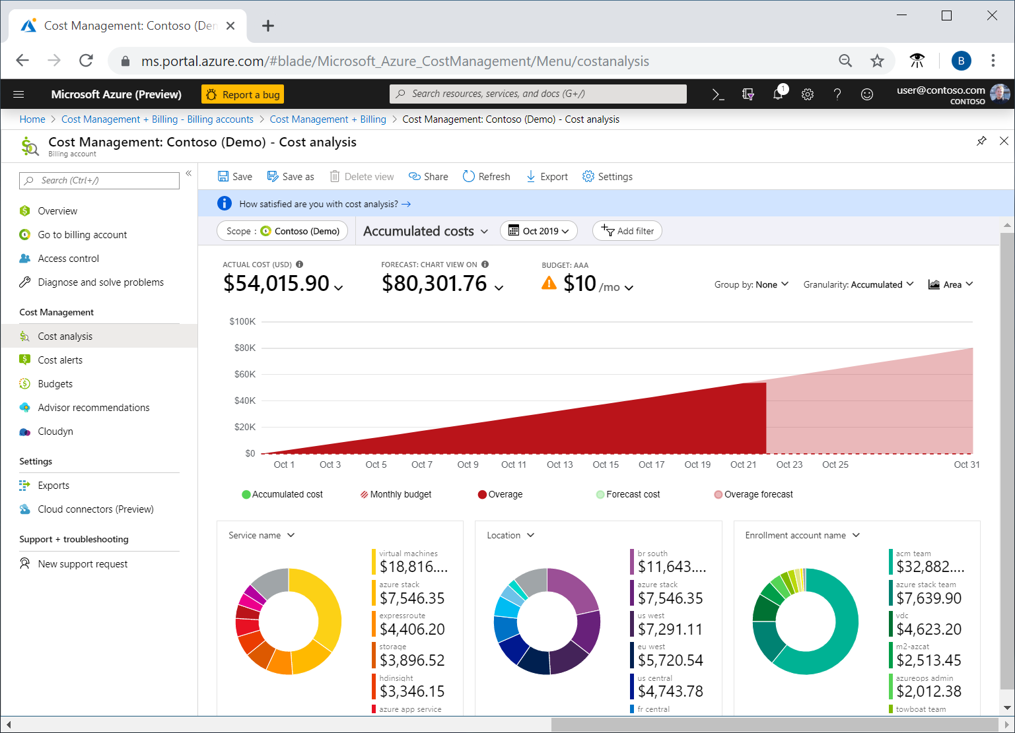
Azure Cost Analysis

Slide 15
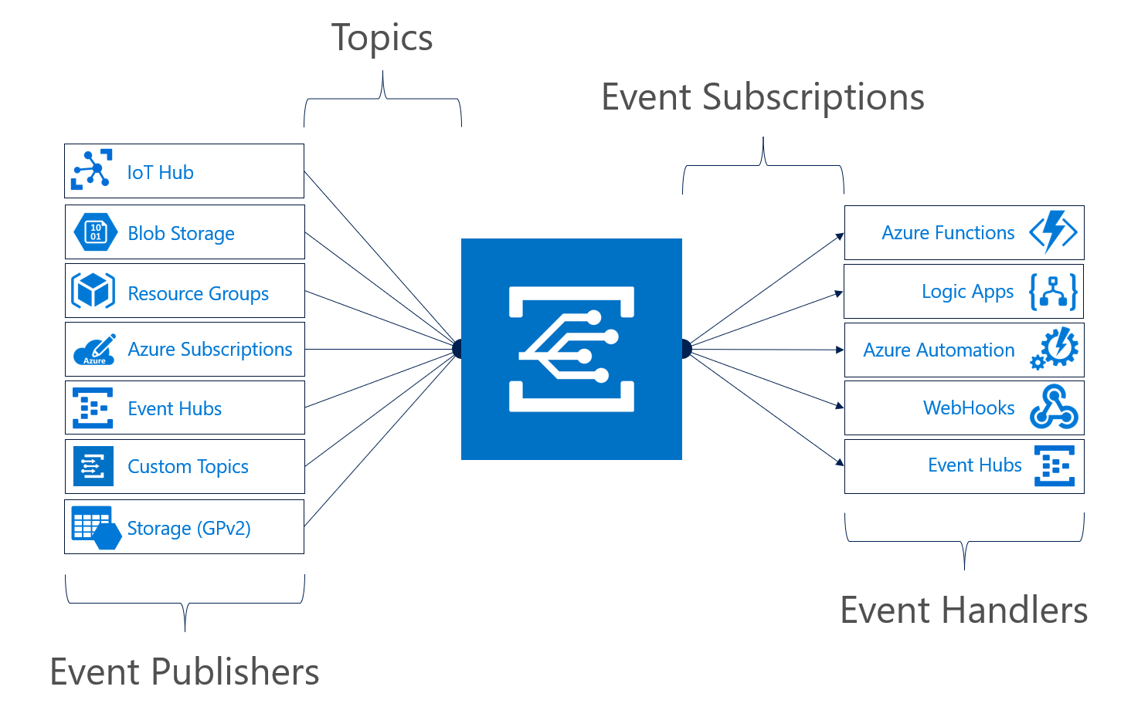
Azure Event Grid

Slide 16
Identity Design

Slide 17

Azure AD SSO
henry.a.miller@companycom.onmicrosoft.com
Cl0udpa$$111!
Henry-miller@company.com
myPa$$w0rd122!

Slide 18
Azure AD SSO
Henry-miller@company.com
myPa$$w0rd122!
Henry-miller@company.com
myPa$$w0rd122!

Slide 19

AD FS Federation

Slide 20


Azure AD and Subscriptions

Slide 21

Azure AD B2C

Slide 22

Azure AD Domain Services

Slide 23
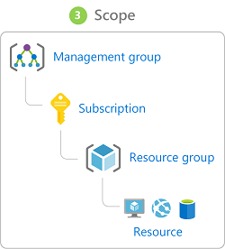
Azure Management Scopes
/ Tenant Root

Slide 24

Passthrough Authentication

Slide 25

Seamless Single Sign-On

Slide 26
Data Platform Solution Design

Slide 27

Availability Set

Slide 28

Availability Zone

Slide 29
Storage Account Replication
1
3
3
2
LRS
ZRS

Slide 30
Storage Account Replication
1
3
1
3
2
2
GRS – RA/GRS

Slide 31
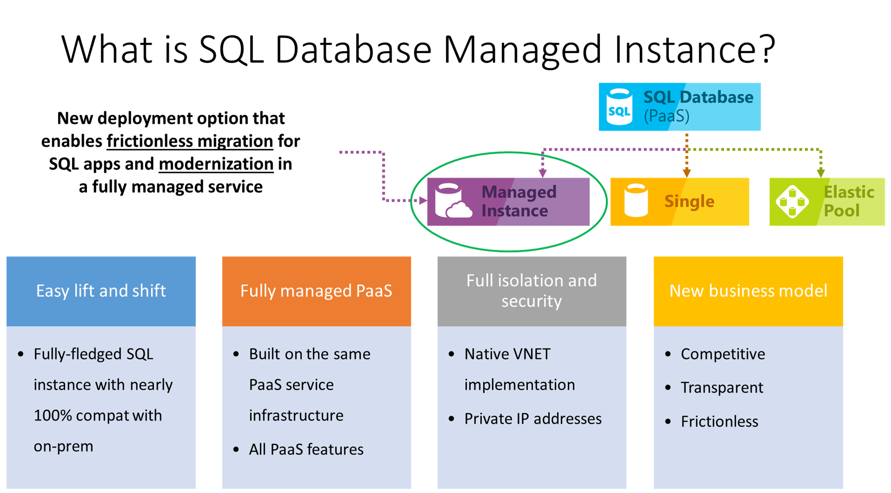

Slide 32
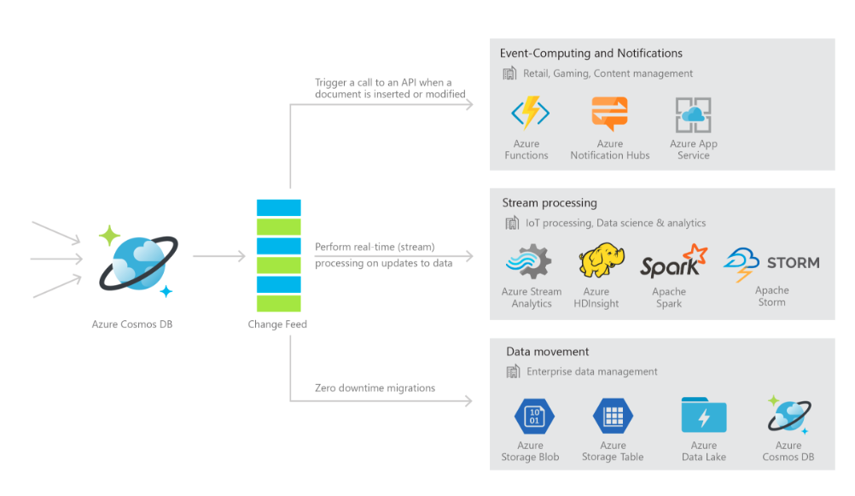
Cosmos DB

Slide 33

Always Encrypted

Slide 34
Business Continuity/High Availability Design

Slide 35
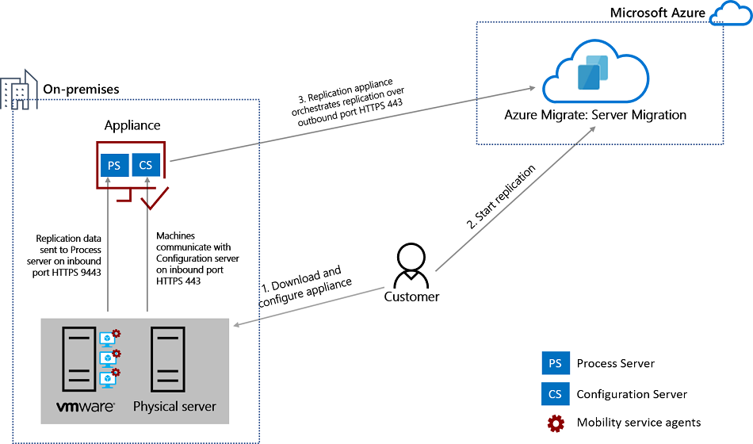
Azure Migrate

Slide 36
Deployment, Migration, Integration Design

Slide 37

VM High Availability

Slide 38

Web App High Availability

Slide 39
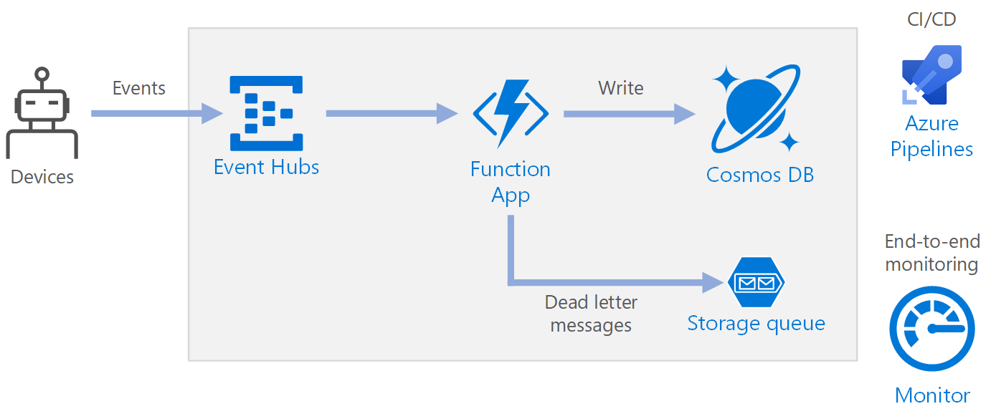
Azure Event Pipeline

Slide 40
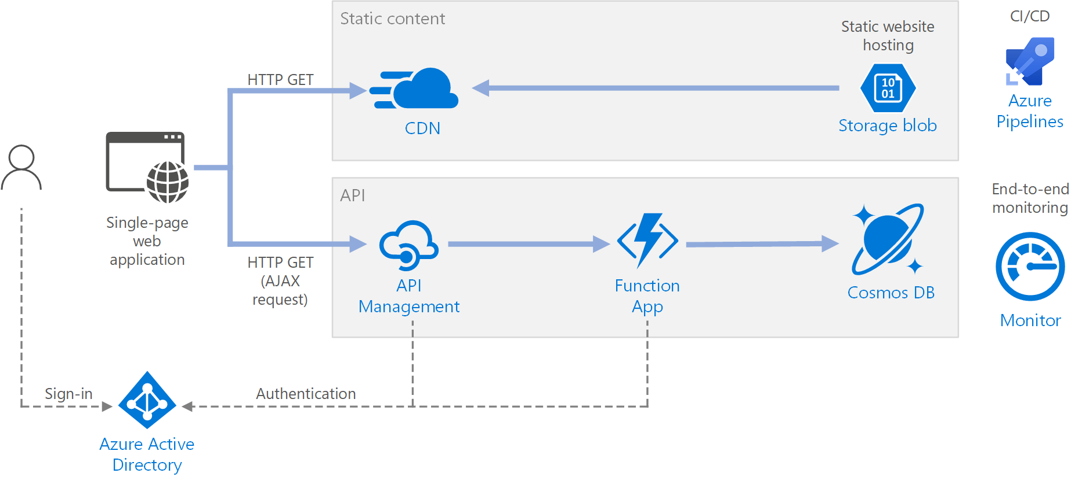
Serverless Web Application

Slide 41
Exam AZ-301 Item Types

Slide 42

Multiple Choice

Slide 43
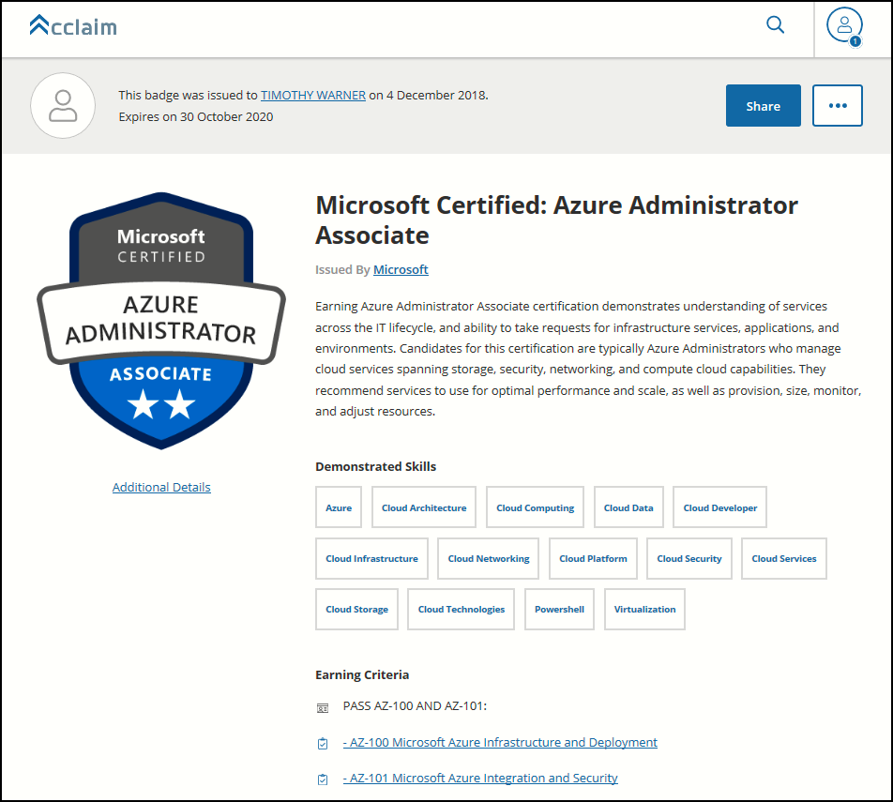
Digital Credentials by Credly/Acclaim

Slide 44
Repeated Scenario
You need to move an Azure VM to another hardware host.
Solution: You redeploy the VM.
Does this solution meet the goal?
Yes
No

Slide 45

Select and Place

Slide 46

Build List and Reorder

Slide 47

Active Screen/Fill in the Blank

Slide 48

Case Study

Slide 49






Performance-Based Lab

Slide 50
AZ-301 Exam Strategy/Tips
Does exam order matter?
What’s the difference between AZ-300 and AZ-301?
Does AZ-301 have performance-based labs?

Slide 51
AZ-301 Exam Strategy/Tips
Focus your skills accordingly:
60 percent Azure portal
20 percent Azure PowerShell
10 percent Azure CLI
10 percent KQL
Expect performance-based labs

Slide 52
AZ-301 Exam Strategy/Tips
Expect to see lots and lots and lots of JSON
Performance-based labs
Open a second tab for shell.azure.com
Don't be afraid to file an item challenge/grievance

Slide 53
Thank you!
Course materials: timw.info/az300
Twitter: @TechTrainerTim
Work: timw.info/ps
Web: TechTrainerTim.com

